Slide 1
Ohio Reach
December 12, 2023
Notes:
My name is Lucy Flowers and I am the new Ohio Reach Coordinator. Ohio Reach is a partnership between Ohio Children’s Alliance, who I work for to coordinate the program, and the Ohio Department of Higher Education (ODHE). I just started November 13 and had some big shoes to fill following my program manager’s footsteps. She has done an amazing job building this program that I get to take over. But I’m here to share with you all because Ohio Reach can be a great resource for Bridges Liaisons to share with students they encounter.

Slide 2
Introduction
Ohio Reach is:
A network of professionals, advocates, and students across the state determined to support former foster youth on their higher education journey
Provide resources to institutions of higher education, child welfare agencies, and foster care alumni enrolled in higher education to support academic success
Through programs like our Postsecondary Designation, Scholarship Fund, and Emergency Fund, we aim to improve retention and graduation outcomes for students in Ohio with a history in foster care
Notes:
Ohio Reach is a network of professionals, advocates, and students across the State determined to support former foster youth on their higher ed journey. We provide resources to institutions of higher ed, child welfare agencies, and foster care alumni enrolled in higher ed to support their academic success.
Through programs like our Postsecondary Designation, Scholarship Fund, and Emergency Fund, we aim to improve retention and graduation outcomes for students in Ohio with a history in foster care. This program is important because research shows that 80% of former foster youth want a degree but 95% do not go to college, so we are working to close this gap!

Slide 3
Qualifications
To participate in Ohio Reach programming, students must have:
Been placed in foster care, kinship care, or other out-of-home placement
Be currently enrolled in an Ohio Institution of Higher Education
Notes:
To participate in Ohio Reach programming, students must have: Been placed in foster care, kinship care, or other out-of-home placement and Be currently or actively enrolled in an Ohio Institution of Higher Education (this includes community colleges, universities, and Ohio Technical Centers, OTCs. Students can be any age to apply for the programming.

Slide 4
Ohio Reach Program Elements
Post-Secondary Designation
Emergency Fund
Scholarship
Notes:
Ohio Reach is made up of three main program elements, one being a Postsecondary Designation that I will explain. Students can also apply for an emergency fund for emergencies like portions of rent, utilities, bus passes, car repairs etc. .Then there is the Ohio Reach Scholarship and I will explain these each in detail.

Slide 5
Postsecondary Designation
Ohio Reach, in partnership with the Ohio Department of Higher Education (ODHE) and The Ohio Children’s Alliance (OCA), launched a designation for accredited colleges, universities, and Ohio Technical Centers to provide supportive services to students with a history in foster care.
The purpose of the Chancellor’s directive is to establish supportive criteria necessary for Ohio’s public and independent colleges and universities and technical centers to be recognized as being supportive and inclusive of foster care-connected students.
The Ohio Reach Designation Advisory Committee will evaluate applications and recommend institutions in Ohio to earn the Ohio Reach Designation.
Designations are awarded for a three-year period, beginning in 2023.
Designated institutions become eligible for micro-grants, free training series, and a support network.
Ohio Reach and ODHE market designated institutions and provide materials to students who are making decisions regarding postsecondary options.
Notes:
First I’ll explain the Postsecondary Designation…Ohio Reach, in partnership with (ODHE) and (OCA), launched this designation for accredited colleges, universities, and Ohio Technical Centers to provide supportive services to students with a history in foster care. This was a directive from ODHE’s Chancellor to establish supportive criteria, necessary for Ohio’s colleges, universities, and technical centers to be recognized as being supportive and inclusive of foster care-connected students. There’s an Ohio Reach Designation Advisory Committee that evaluates applications and recommend institutions in Ohio to earn the Designation. Designations are awarded for a three-year period, beginning in 2023. Schools can apply every spring, though. Designated institutions become eligible for micro-grants, free training series, and a support network. Ohio Reach and ODHE market designated institutions and provide materials to students who are making decisions regarding postsecondary options.

Slide 6
Supports Offered
Designated Liaison/Point of Contact
"Champions" in Various Campus Departments
Ability to connect students to resources (community and campus)
Community Building Opportunities for Students
Targeted Outreach
Expanding the eligibility of on-campus resources
Staff training on working with former foster youth
Succession/Transition Planning (For Liaisons)
Data collection
Mentorship Program
Notes:
So to be awarded the Ohio Reach Postsecondary Designation, the institution is required to offer the following supports and as you can see it’s a robust list!
Designated Liaison
They must determine a designated Single Point of Contact for students and organizations (with lived experience in or deeper understanding of Foster Care when possible).
Campus Champions
They must identify Champions in a minimum of three campus departments. Departments can be like Academic Advising, Housing, Financial Aid, Student Support Services, etc..
Community Resources
The Liaison must be able to connect students to resources, both on-campus and community. These resources include: ETV Funding, Bridges, housing resources, and food and other community resources.
Community Building Opportunities
They must have community building opportunities. This can include events like social dinners, “Lunch N Learn” opportunities, group outings and study groups.
Targeted Outreach
Colleges must engage in targeted outreach to students, with efforts made to identify and support them.
Expanding the Eligibility of On-Campus Resources
Efforts should be made to expand the eligibility of programs (group counseling, additional tutoring services, career counseling, and mentorship for example) to include alumni of foster care, or to connect Ohio Reach students with these resources.
Staff Training
Ohio Reach offers free, online training and resources to Campus Liaisons and Champions. These trainings will cover topics from working with alumni of foster care to best practices for on-campus resources.
Succession planning
They must have a plan in place if one liaison leaves the position on who might take over the program.
Data Collection and Mentorship
Campus Liaisons must collect/report non-identifying student data, and then each university program must offer a Mentorship program to Ohio Reach students. Like Community Building Opportunities, Ohio Reach students report that Mentorship is one of the most important resources, giving them the support and feeling of security that they need.

Slide 7
Year-Round Housing
Career Counseling (In addition to regular offerings)
Cohort Structure
Tutoring Resources Specifically for FFY
Community Leadership Opportunities
Life Skills Learning Opportunities
Transition Services
Notes:
And then these elements such as year-round housing, cohort structures for FFY, tutoring, leadership opportunities, life skills learning, and transition services are not required but are highly encouraged. Some or many may offer these resources.

Slide 8
Columbus State Scholar Network

Slide 9
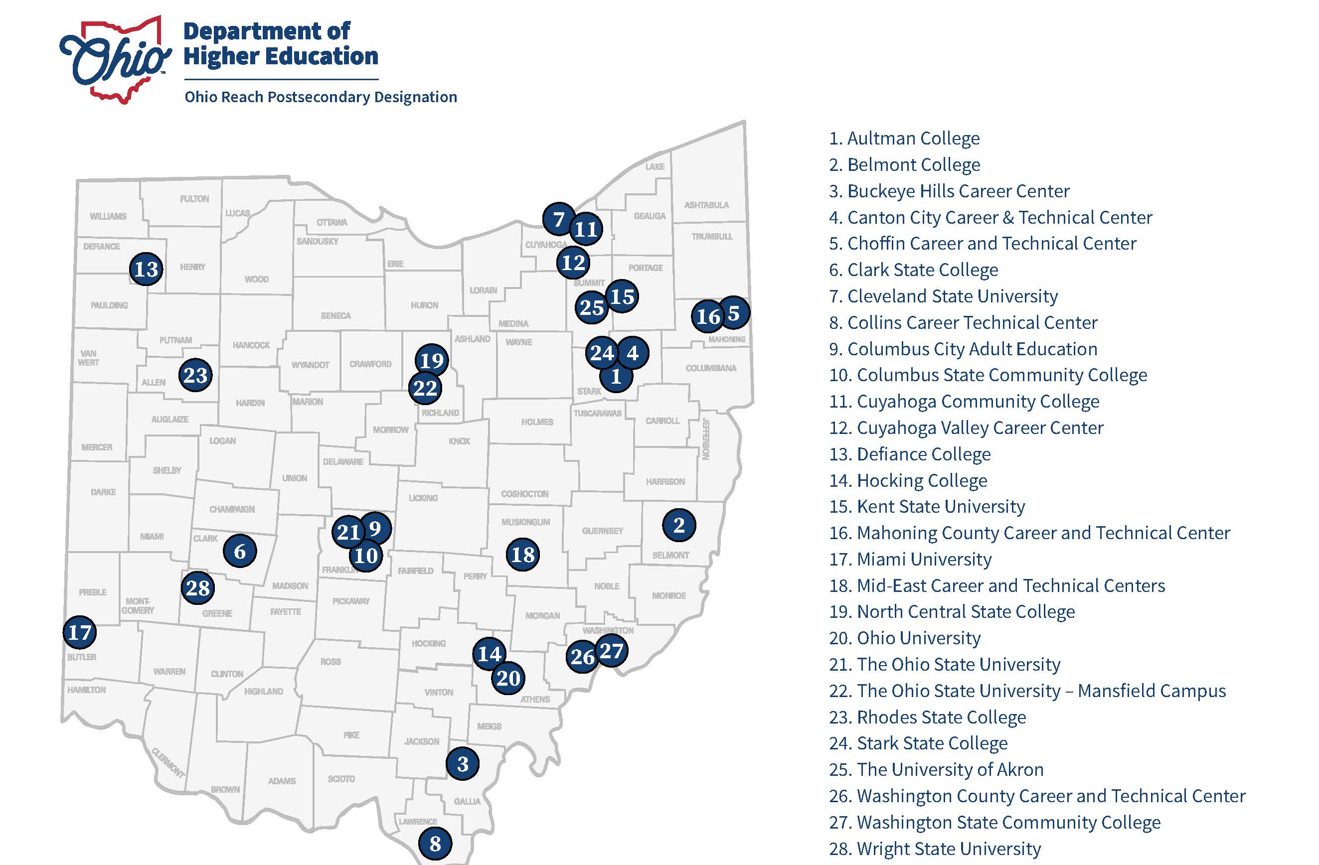
Notes:
Each of these colleges, universities, or OTCs has earned the postsecondary designation and offer the required elements of the program. Each college may call their program something different, like Kent state has a “Purple Umbrella Network” and Columbus State is “The Scholar Network”, but each school has a designated liaison and champions. If one of your students attends these schools, they should reach out to the campus liaison. The first round of postsecondary designations was just earned in 2023 (good for 3 years) and a list of contacts will be coming soon on our website. If you know of a school not on the list, let us know and maybe I can reach out to see if they are interested in applying for the designation this spring, as the RFA should come out in late Jan early Feb of 2024.

Slide 10
Emergency Fund
The Ohio Reach Emergency Fund is available to Ohio Postsecondary students with a history in foster care who are facing an Emergency or unexpected situation. Students are eligible once per year to apply.
Notes:
The Ohio Reach Emergency Fund is available to postsecondary students with a history in foster care who are facing an Emergency or unexpected situation. Students are eligible once per year to apply or once during a 12-month period. There is no age limit on this, and we get a lot of applications. Max is 8-900 but we work with them. We ask for a cost breakdown and current class schedule after students apply and share other resources if we cannot help or fully help them with their needs. Students do not have to attend a Postsecondary Designated school to apply.

Slide 11
Scholarship
Opens once per year
Currently in school or enrolled High School Seniors may apply
Each year, three students are awarded the renewable scholarship (fall/spring)
For $1,000 per semester, renewable for up to 5 years
Notes:
The Ohio Reach Scholarship opens once per year. Students who are currently in school or enrolled High School Seniors may apply. Each year, three students are awarded the renewable scholarship. Scholarships are for $1,000 per semester, renewable for up to 5 years. Students do not have to attend a Postsecondary Designated school to apply. The Scholarship must be used initially on school fees but can be applied to other needs like books and travel, if all fees are covered first.

Slide 12
Connecting Students
Students who are attending or interested in attending an Ohio Reach designated institution should directly contact the school liaison.
The Emergency Fund and Scholarship Application→OhioReach.org
Resources→OhioReach.org
Notes:
Students who are attending or interested in attending an Ohio Reach designated institution should directly contact the school liaison. The Emergency Fund and Scholarship Application can both be found at OhioReach.org, Resources are also found at OhioReach.org

Slide 13
Questions?
Contact:
Lucy.flowers@ohiochildrensalliance.org

